Slide 1

04/27/2025
THREAT INTELLIGENCE PLATFORM
Project Manager: Haley Nilsen
Frontend Developer: Montana Nicholson
Database Developer: Toan Nguyen
Backend (API) Developer: Samuel Yohannes
Github Manager: Jack Keys

Slide 2
INTRODUCTION
This system automates cybersecurity threat gathering, analysis, and prioritization. The backend implements SQLite for the database, Redis caching, Shodan/OSINT feeds, and OpenAI risk analysis. The frontend is a dynamic dashboard that uses charts (from Chart.js), alerts, and displays risk prioritization.

Slide 3

KEY OBJECTIVES
Real-time threat intelligence
Risk ranking and prioritization
Rapid altering for faster incident response
High performance with Redis caching
User-friendly, scalable design

Slide 4

SYSTEM ARCHITECTURE
Frontend (React.js): Real-time threat data, OSINT results, alerts, TVA mappings (charts)
Backend (Node.js/Express.js): APIs for threat analysis, risk prioritization, and alerting
Database (SQLite): Stores threats, alerts, TVA mappings
Caching (Redis): Accelerates repeated IP lookups
Flow:
User → Dashboard → Backend → Redis → SQLite → OSINT → Frontend displays results

Slide 5
SECURITY FEATURES
API Validation: Protects against SQL injection
CORS restrictions: Only allows frontend-origin API calls
Redis Caching: Reduces database load by serving cached IP data
Automated Alerts: Notifies blue teams of high-risk threats instantly
Threat Hunting: Supports both manual investigations and scheduled OSINT updates

Slide 6
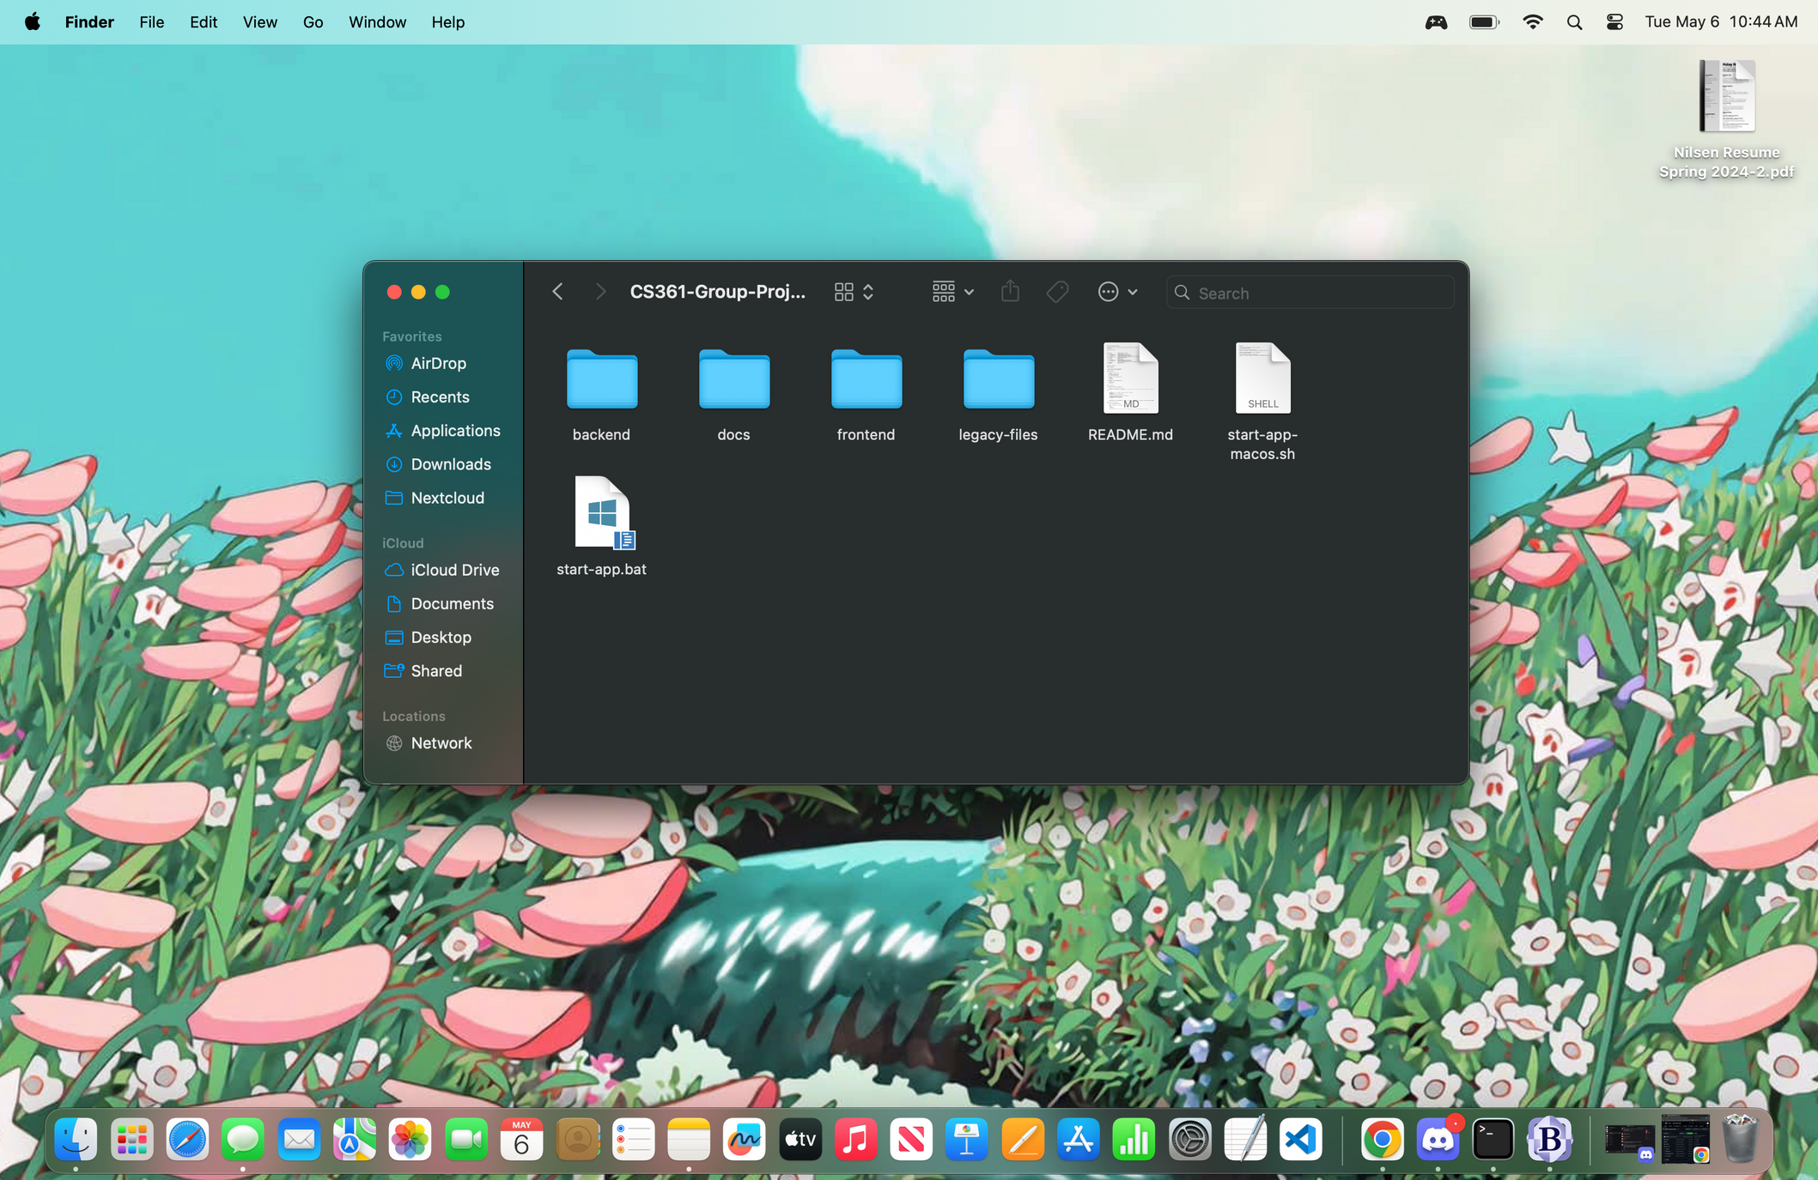
DEMONSTRATION
After cloning the repo, navigate to the file directory.

Slide 7
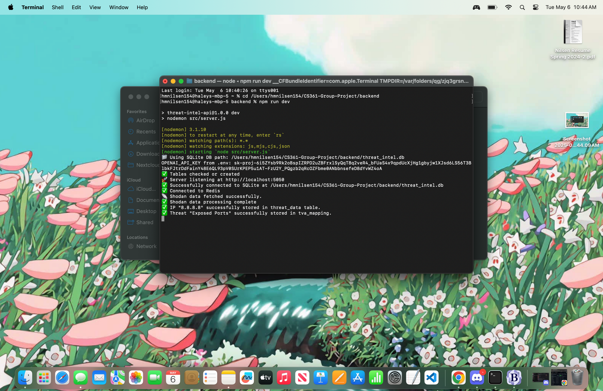
DEMONSTRATION
Copy the file path for the backend and run cd /filepath in the terminal and run ‘npm run dev’
cd .../backend
npm run dev
messages from backend indicating that the server is running properly!

Slide 8
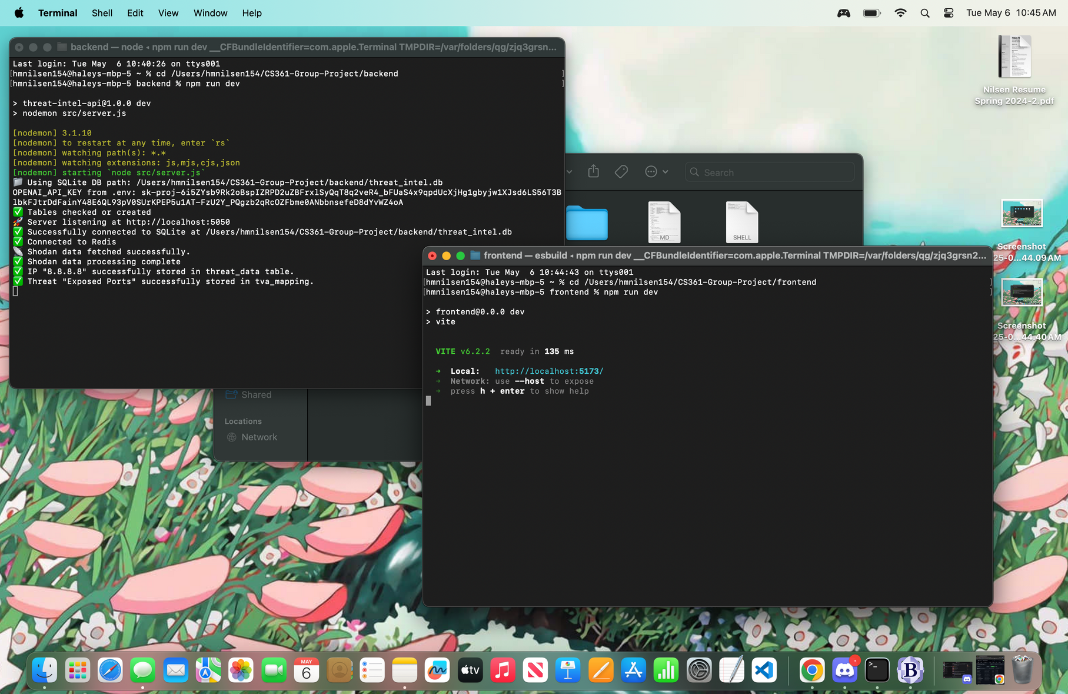
DEMONSTRATION
Repeat the process for the frontend folder.
cd .../frontend
npm run dev
message from frontend that it is properly running! copy this localhost url to navigate to dashboard.

Slide 9
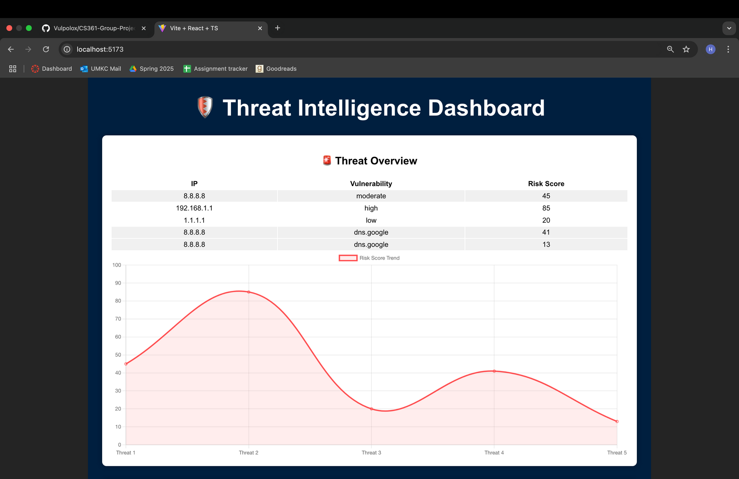
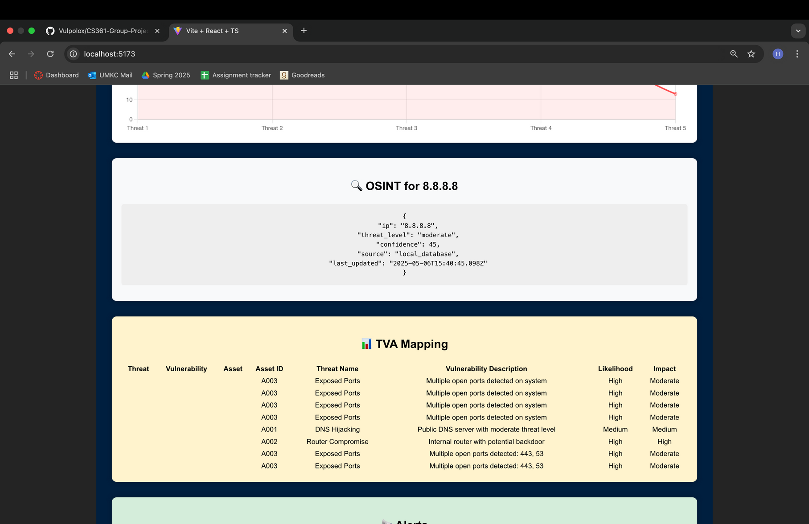
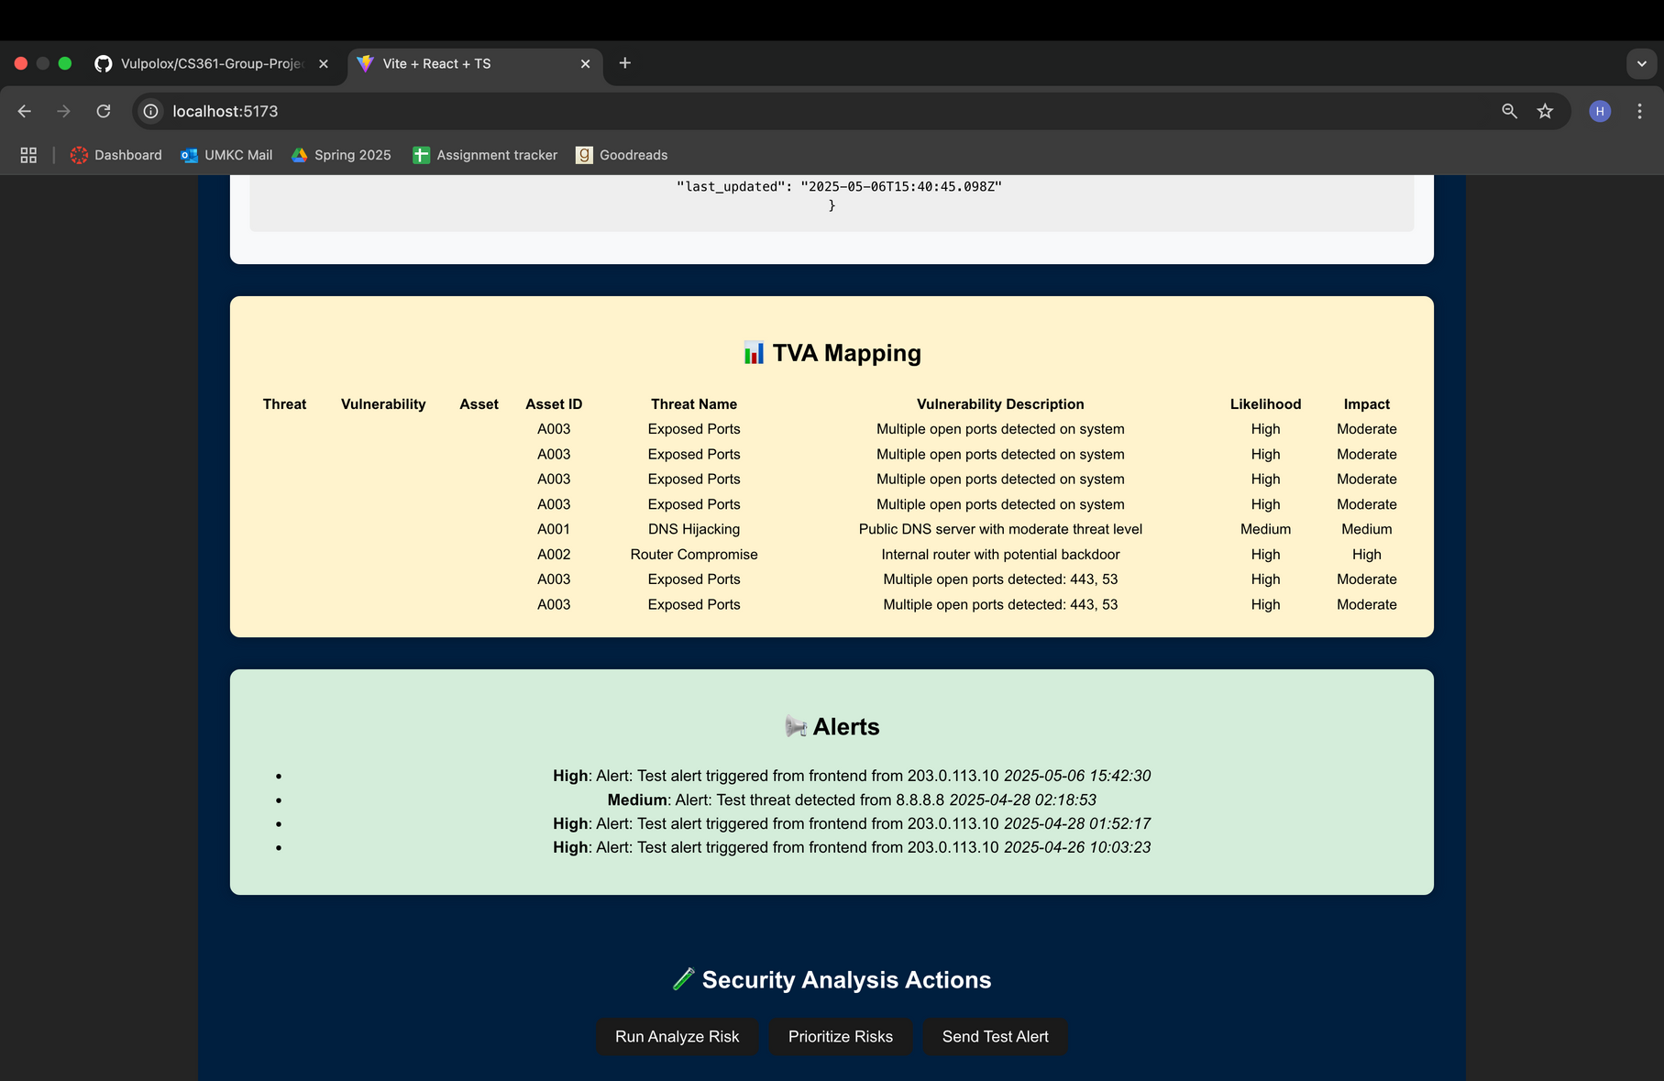
DEMONSTRATION
Threat Dashboard
When loading the frontend, users will see the main dashboard. Within the first chart and graph, users see the vulnerabilities for each tested IP and the risk score that is associated with them. This is mapped on the graph below the table. Users will also see the OSINT search for the given IP and the corresponding results.
There are also elements to display the TVA Mapping results and security alerts for different IP addresses.

Slide 10
DEMONSTRATION
Threat Dashboard

Slide 11
DEMONSTRATION
Threat Dashboard

Slide 12
DEMONSTRATION
Threat Dashboard

Slide 13

SECURITY AND LOAD TESTING
ZAP Scan: Medium vulnerabilities found, but no critical vulnerabilities.
JMeter Load Test: Quick responses with a 0% error rate.
Performance: API response time under 100ms for all requests

Slide 14
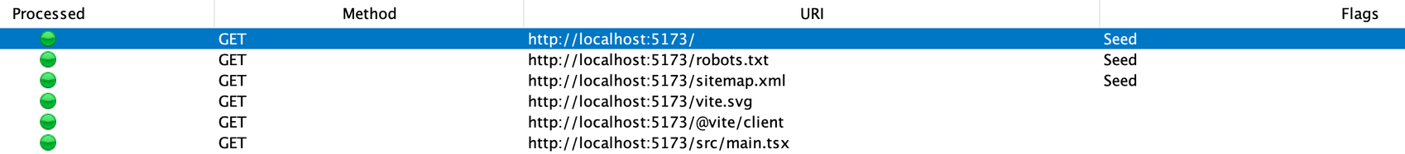
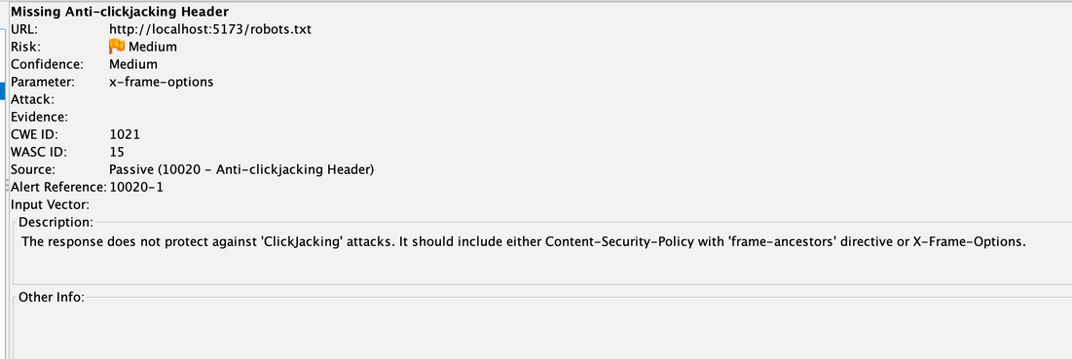
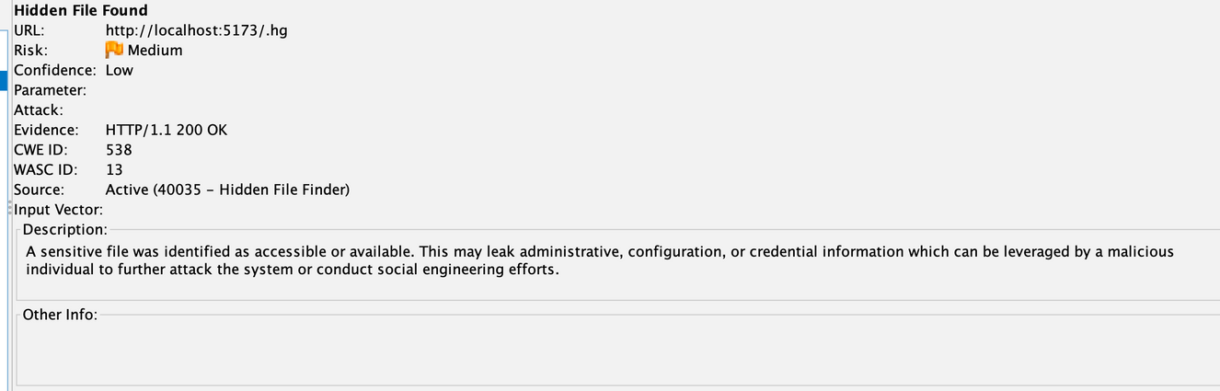
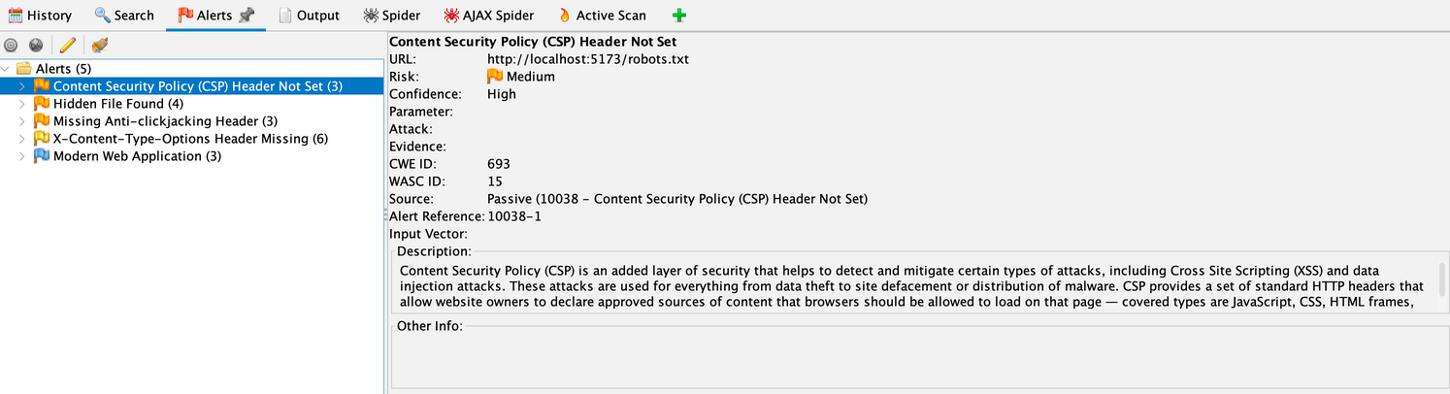
ZAP SCAN
Three medium vulnerabilities were found on the automated attack. These are vulnerabilities that are serious enougn to review to avoid more severe attacks, but are not catastrophic on their own.

Slide 15
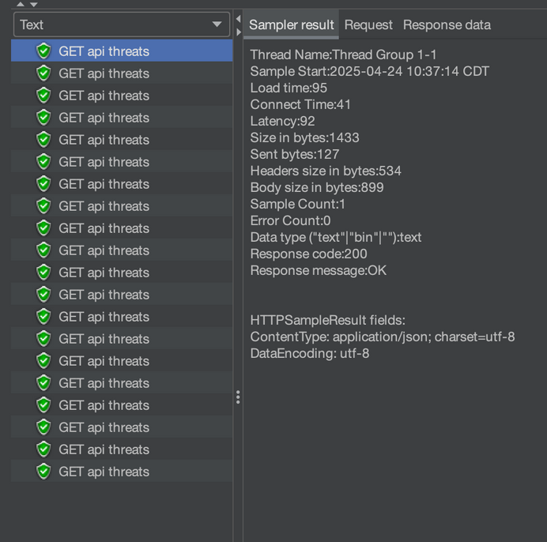

JMETER LOAD TEST
When running the JMeter test, the results showed a 0% error rate and an average response time of 9ms. The fastest response time recorded was 2ms, and the slowest was 95ms. This was tested with 20 samples.

Slide 16
COST & BUSINESS JUSTIFICATION
Redis: Free local, $5/month cloud option
SQLite: Free
Shodan API: Free tier, upgrades optional
Value: Faster identification, lower branch risk, immediate ROI, and scalable for future growth

Slide 17
CHALLENGES & LESSONS LEARNED
Challenges: Shodan integration issues, missing fallback logic, dependency setup problems
Lessons Learned:
Create package.json early
Use .env files for configs
Better project structure to avoid file errors

Slide 18
FUTURE ENHANCEMENTS
Add authentication to secure APIs
Implement role-based dashboards (Admin vs Analyst views), this can include a login page that allows those designated users to view the dashboard.
Create scheduled automated reports for threat summaries
Address ZAP threats:
Prevent against clickjacking attacks → make sure site is not embedded into an <iframe>
API Key file is shown as available → hide file so user’s API keys are not at risk of attack
Implementing a Cross Security Policy (CSP) Header → protects site against cross-scripting (XSS) attacks

Slide 19

THANK YOU

